Slide 1
DoD Ex-Officio Transition Support October 2018
Ms. Kathleen Facon
DoD Ex-Officio Member

Slide 2
DoD Role in Military Interstate Children’s Compact
The DoD supports the Compact by:
Designating the ex-officio member to the Military Interstate Children’s Compact Commission (MIC3)
Designating a military representative, by position, to State Councils
Implementing policy thorough the Department of Defense Instruction 1342.29 “Interstate Compact on Educational Opportunity for Military Children”
Ensuring Department of Defense Education Activity (DoDEA) schools comply with the DoD Policy to operationalize the Compact
Military Services School Liaison Officers serve to support transition issues impacting military connected students and facilitate solutions within the compact rules

Slide 3
About DoDEA Organization Snapshot
80%
Attend non-DODEA schools
166
schools
approximately
72,000
PK-12 military-connected students
DoDEA shares its resources to support successful educational outcomes for military dependent students who attend public LEAs through a competitive grant program.
Notes:
As this slide indicates, DoDEA covers a wide geographical area and serves a variety of educational needs. In addition to operating 172 schools, DoDEA provides support to the majority of military families whose children attend public and private schools across the U.S. DoDEA’s vision as a school district is to be among the World's leaders in education, enriching the lives of military dependent students and the communities in which they live. With over 80% of the school-aged children of military families attending schools outside of the gate, DoDEA shares its resources to support expansion of educational opportunities for those children from military families through a competitive grant program.

Slide 4
Military-Connected Student Transition Support
Active grantees providing military transition support
Active grantees with dedicated military support personnel and programs
Total Students Impacted
Military-connected students impacted (91,936)
Participating Schools
58
33
322,838
28%
397
Notes:
Grantees with military transition support – grantees with direct student services that match the 5 categories from MIC3
Grantees with dedicated military support programs – grantees with dedicated military support personnel and/or peer support programs
Data from 2018 Spring Semester Report (SY 2017-2018)

Slide 5
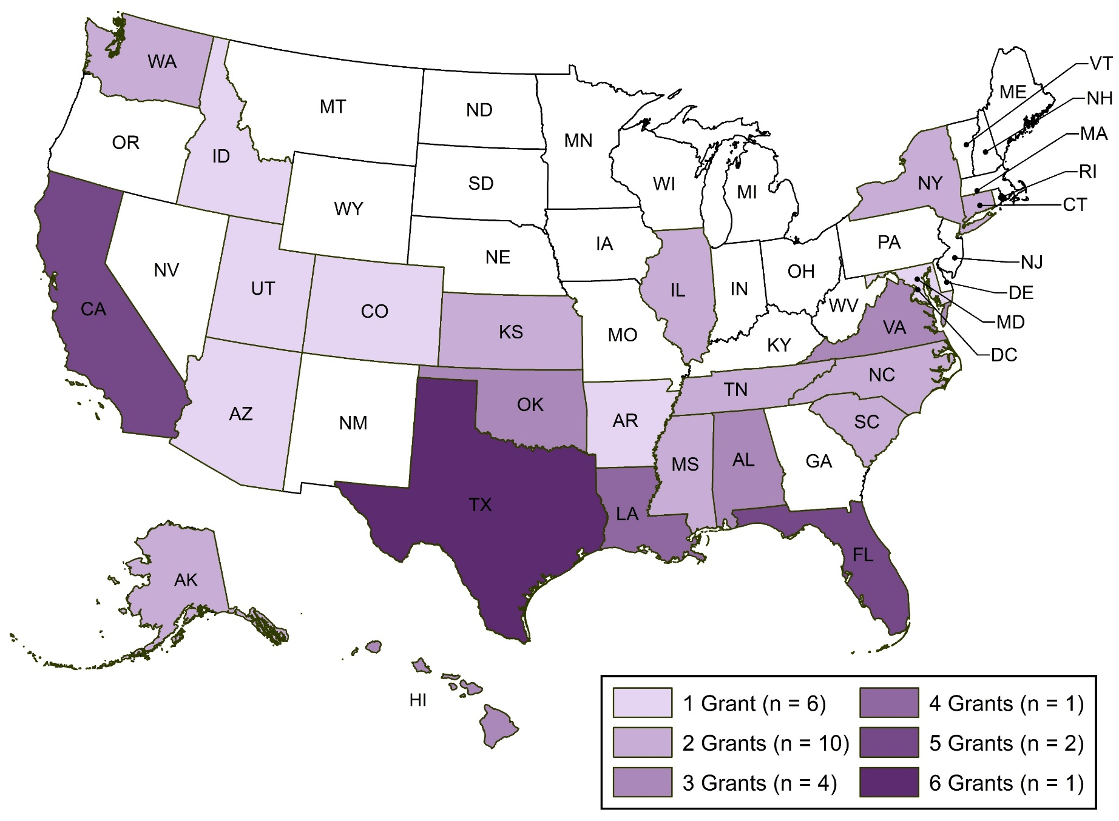
DoDEA Grants with Military-Connected Student Transition Support, by State
Notes:
Option 1

Slide 6
DoDEA Grants: Transition Support by State
State | Count
TX | 6
CA | 5
FL | 5
LA | 4
AL | 3
HI | 3
OK | 3
VA | 3
AK | 2
CT | 2
IL | 2
KS | 2
State | Count
MS | 2
NC | 2
NY | 2
SC | 2
TN | 2
WA | 2
AR | 1
AZ | 1
CO | 1
ID | 1
MD | 1
UT | 1
Notes:
Option 2

Slide 7
DoDEA Grants: Transition Support by Cohort
Notes:
N=58 DoDEA grantees with MIC3 related military transition support

Slide 8
DoDEA Grants: Transition Support by Category
Notes:
Percentages
Grantees may have more than one type of transition support

Slide 9
DoDEA Grants: Transition Support by Category and Cohort
Notes:
Most used support:
2014 Cohort – Placement
2015 cohort – Eligibility
2016 Cohort – Graduation
2017 Cohort – Eligibility
Grantees may have more than one type of transition support

Slide 10
Grantee Spotlight: Bossier Parish School Board (2017)
Project Title: | Project TACTICAL (Teaching And Connecting Through Interactive Classroom And Language Arts)
City, State: | Benton, LA
Military Installations Served: | Barksdale AFB
Grade Levels: | K-8
Number of Military-Connected Students Impacted: | 1,245 (19%)
Number of Participating Schools: | 11
Types of Transitional Support: | Enrollment, Placement
Military Support Personnel/Programs | Counselors, PCS Facilitator, Peer Mentoring

Slide 11
Grantee Spotlight: Bossier Parish School District (2017)
Focus: Improving academic, social, and emotional outcomes of military-connected students receiving free or reduced lunch
Military Support Personnel/Programs:
School-Based Counselors
PCS Facilitator
Peer Mentoring
Transitional Support Services:
Enrollment:
Developed app to facilitate the connection between military-connected families and social, emotional, and academic supports (in collaboration with Texas A&M University)
Parent Lecture Series to encourage parent involvement
Placement:
Response to Intervention (RtI) programs
Individual counseling services

Slide 12
Grantee Spotlight: Cache Public Schools (2015)
Project Title: | The Cache FLOW (Future Leaders of the World) Project II
City, State: | Cache, Oklahoma
Military Installations Served: | Fort Sill, Altus AFB
Grade Levels: | K-12
Number of Military-Connected Students Impacted: | 708 (33%)
Number of Participating Schools: | 3
Types of Transitional Support: | Eligibility and graduation
Military Support Personnel/Programs | Counselors, Education Coordinator

Slide 13
Grantee Spotlight: Cache Public Schools (2015)
Focus: Improving military-connected student academic achievement in grades K-12
Military Support Personnel/Programs:
Education Coordinator at Fort Sill
Student Ambassador Leadership Program
Transitional Support Services:
Eligibility:
Tutors
STEM based Extracurricular activities
Afterschool programs; Lego club/robotics
Partnership with Great Plains Technology Center
Graduation:
Credit recovery (includes virtual learning/flipped classrooms); ACT Bootcamp
Outcomes:
Overall increase in science (9-12), math (4-8), and reading (K-3) for military-connected students.
Highlight: 23 percentage point increase in military-connected students in grades 9-12 scoring proficient or above on End-of-Instruction Science tests (baseline=48%, year 1=71%)
Notes:
Pre-engineering program,
Education Coordinator facilitates recruitment/coordination with parents/teachers for afterschool and extracurricular clubs

Slide 14
Ex-Officio Member Contact Information
Kathleen M. Facon
Chief, Education Partnership and Resources, DoDEA
4800 Mark Center Drive
Alexandria, VA 22350
Office: 571-372-5834
Cell: 703-459-8333

Slide 15
Relevant Resources
Military Representative Guide Book:
http://www.mic3.net/
DoDEA Compact Page:
https://www.dodea.edu/Partnership/upload/mic3_mil_rep_ebook_10-16-2017_final.pdf
Military OneSource - "Helping Your Children Change Schools":
https://www.militaryonesource.mil/-/helping-your-children-change-schools

