Slide 1
MIC3 – Military Interstate Children’s Compact Commission - 2020
Davis Whitfield
Chief Operating Officer, NFHS

Slide 2
PROVIDING PARTICIPATION OPPORTUNITIES
ABOUT THE NFHS

Slide 3
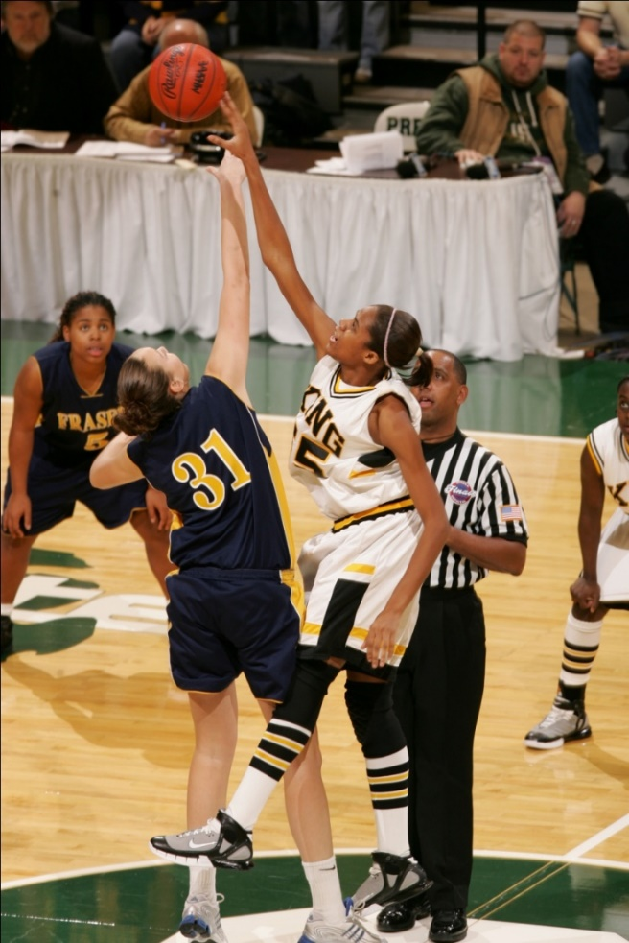
National Federation of state High School Associations
NFHS
Located in Indianapolis, IN
Established in 1920
40-Person staff
National Leader and advocate for high school athletics as well as fine and performing arts activities
Writes playing rules for 17 sports
70+ education courses on NFHSLearn.com
Serve 19,500 high schools
51 State Associations
Notes:
About the National Federation of State High School Associations (NFHS) cont:
The NFHS, based in Indianapolis, Indiana, is the national leadership organization for high school sports and fine arts activities. Since 1920, the NFHS has led the development of education-based interscholastic sports and fine arts activities that help students succeed in their lives. The NFHS sets direction for the future by building awareness and support, improving the participation experience, establishing consistent standards and Rules for competition, and helping those who oversee high school sports and activities. The NFHS writes playing Rules for 17 sports for boys and girls at the high school level. Through its 50 member state associations and the District of Columbia, the NFHS reaches nearly 19,000 high schools and 11 million participants in high school activity programs, including more than 7.6 million in high school sports.

Slide 4
National Federation of State High School Associations
VISION
The National Federation of State High School Associations (NFHS) is the national leader for education-based high school athletics and activities, which prepare tomorrow’s leaders for the next level of life through innovative programs, healthy participation, achievement, and development of positive relationships

Slide 5
National Federation of State High School Associations
MISSION
The National Federation of State High School Associations (NFHS) serves its members by providing leadership for the administration of education-based high school athletics and activities through the writing of playing rules that emphasize health and safety, educational programs that develop leaders, and administrative support to increase participation opportunities and promote sportsmanship.

Slide 6
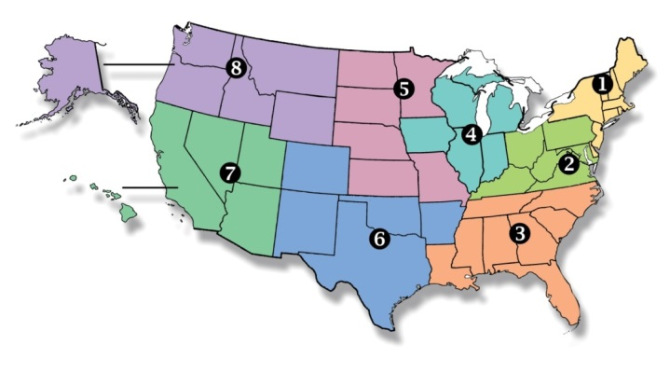
National Federation of state High School Associations
Membership – 50 member state associations and D.C.
NFHS reaches 19,500 plus high schools and 12 million participants in high school activity programs, including more than 8 million in high school sports.
Notes:
About the National Federation of State High School Associations (NFHS) cont:
The NFHS, based in Indianapolis, Indiana, is the national leadership organization for high school sports and fine arts activities. Since 1920, the NFHS has led the development of education-based interscholastic sports and fine arts activities that help students succeed in their lives. The NFHS sets direction for the future by building awareness and support, improving the participation experience, establishing consistent standards and Rules for competition, and helping those who oversee high school sports and activities. The NFHS writes playing Rules for 17 sports for boys and girls at the high school level. Through its 50 member state associations and the District of Columbia, the NFHS reaches nearly 19,000 high schools and 11 million participants in high school activity programs, including almost 7.5 million in high school sports.

Slide 7
National Federation of state High School Associations
Each state governs athletics as well as fine and performing arts activities
Eligibility
Age
Academics
Residence
Sports seasons
School of residence
Waivers
Opportunities to participate
Transition
Notes:
About the National Federation of State High School Associations (NFHS) cont:
The NFHS, based in Indianapolis, Indiana, is the national leadership organization for high school sports and fine arts activities. Since 1920, the NFHS has led the development of education-based interscholastic sports and fine arts activities that help students succeed in their lives. The NFHS sets direction for the future by building awareness and support, improving the participation experience, establishing consistent standards and Rules for competition, and helping those who oversee high school sports and activities. The NFHS writes playing Rules for 17 sports for boys and girls at the high school level. Through its 50 member state associations and the District of Columbia, the NFHS reaches nearly 19,000 high schools and 11 million participants in high school activity programs, including almost 7.5 million in high school sports.

Slide 8
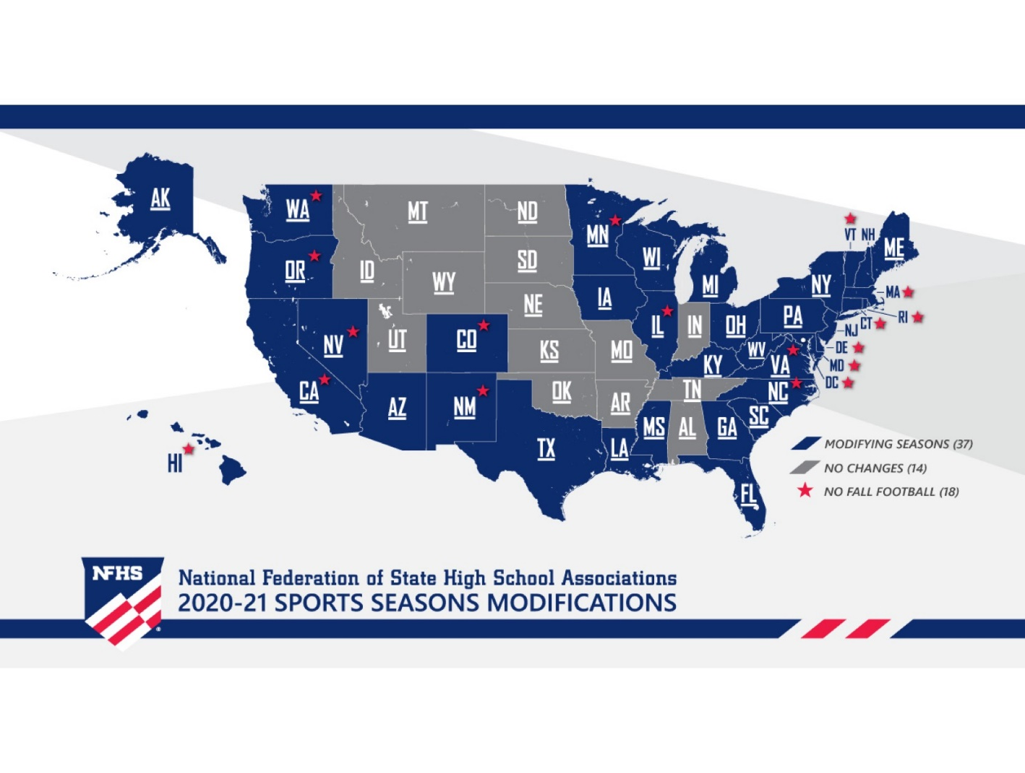
National Federation of state High School Associations
Sports Seasons
Covid-19
Transfers
Notes:
About the National Federation of State High School Associations (NFHS) cont:
The NFHS, based in Indianapolis, Indiana, is the national leadership organization for high school sports and fine arts activities. Since 1920, the NFHS has led the development of education-based interscholastic sports and fine arts activities that help students succeed in their lives. The NFHS sets direction for the future by building awareness and support, improving the participation experience, establishing consistent standards and Rules for competition, and helping those who oversee high school sports and activities. The NFHS writes playing Rules for 17 sports for boys and girls at the high school level. Through its 50 member state associations and the District of Columbia, the NFHS reaches nearly 19,000 high schools and 11 million participants in high school activity programs, including almost 7.5 million in high school sports.

Slide 9
National Federation of state High School Associations
Questions to ask….
Are you interested in participating in interscholastic sports?
Are you academically eligible based on (current and future) state association eligibility requirements?
Are you eligible based on attendance?
Are you attending the school in your area of residence?
Waiver?
Are you living with your legal custodian?
Is your pre-participation physical up to date?
Any questions that may arise, contact your state association office!
Notes:
About the National Federation of State High School Associations (NFHS) cont:
The NFHS, based in Indianapolis, Indiana, is the national leadership organization for high school sports and fine arts activities. Since 1920, the NFHS has led the development of education-based interscholastic sports and fine arts activities that help students succeed in their lives. The NFHS sets direction for the future by building awareness and support, improving the participation experience, establishing consistent standards and Rules for competition, and helping those who oversee high school sports and activities. The NFHS writes playing Rules for 17 sports for boys and girls at the high school level. Through its 50 member state associations and the District of Columbia, the NFHS reaches nearly 19,000 high schools and 11 million participants in high school activity programs, including almost 7.5 million in high school sports.

Slide 10
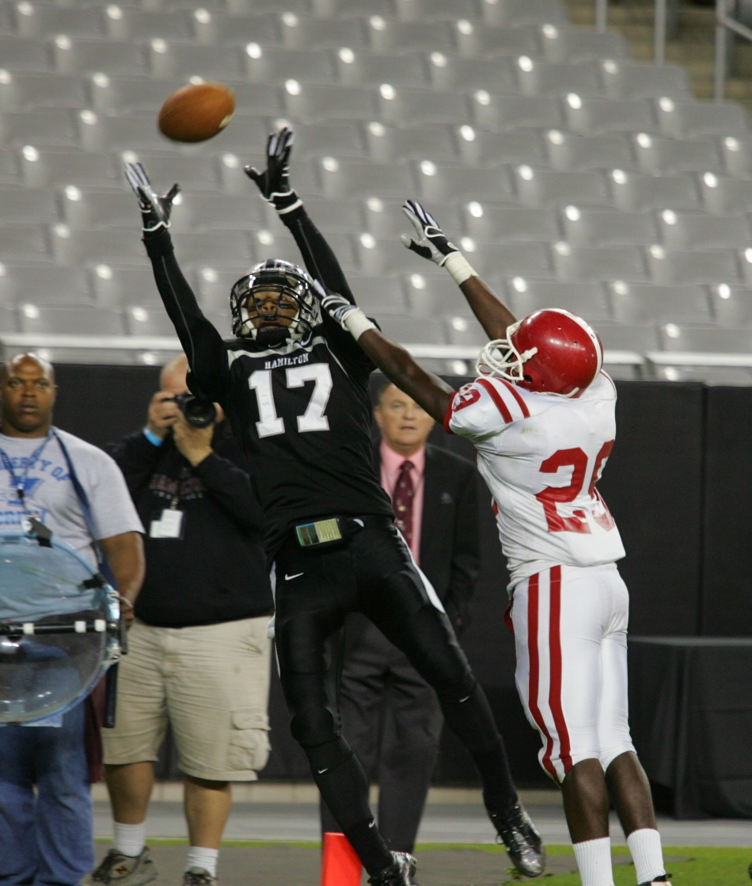
National Federation of state High School Associations
Do you have a state association representative on your state council?
Do you (SLO’s) have periodic contact with your state association representative?
Case studies
Notes:
About the National Federation of State High School Associations (NFHS) cont:
The NFHS, based in Indianapolis, Indiana, is the national leadership organization for high school sports and fine arts activities. Since 1920, the NFHS has led the development of education-based interscholastic sports and fine arts activities that help students succeed in their lives. The NFHS sets direction for the future by building awareness and support, improving the participation experience, establishing consistent standards and Rules for competition, and helping those who oversee high school sports and activities. The NFHS writes playing Rules for 17 sports for boys and girls at the high school level. Through its 50 member state associations and the District of Columbia, the NFHS reaches nearly 19,000 high schools and 11 million participants in high school activity programs, including almost 7.5 million in high school sports.

Slide 11
Contact Information
Davis Whitfield, Chief Operating Officer
National Federation of State High School Associations
PO Box 690
Indianapolis, Indiana 46206
Office Phone: 317.822.5758
E-mail: dwhitfield@nfhs.org
Website: www.nfhs.org
Education Website: www.nfhslearn.com
Notes:
Contact Information:
SOCCER EDITOR:
Mark Koski, CMAA, Director of Sports, Events and Development
Soccer Rules Editor and National Interpreter
National Federation of State High School Associations
PO Box 690
Indianapolis, Indiana 46206
Office Phone: (317) 972-6900
E-mail: mkoski@nfhs.org
Website: www.nfhs.org

